Slide 1
CS4038
DATA MINING
LECTURE # 01
FALL 2024
FAST – NUCES, CFD CAMPUS
Ayesha Liaqat
ayesha.liaqat@nu.edu.pk

Slide 2
TODAY’S TOPICS
Background of the class
Introduction to Data Mining
Introduction
Myself
Course & Conduct

Slide 3




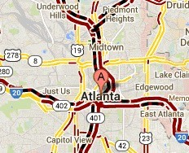
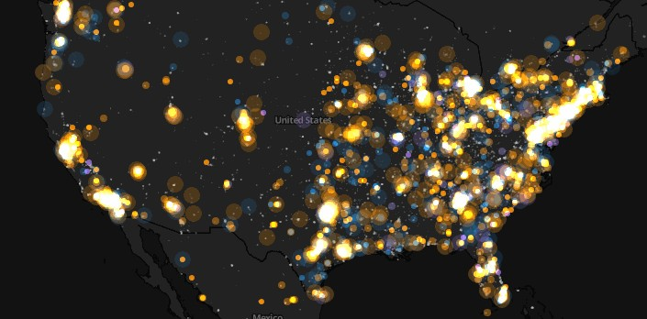
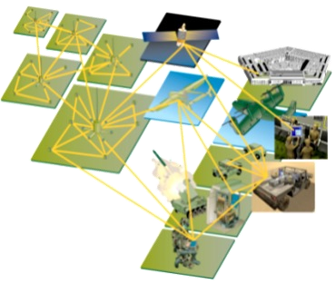
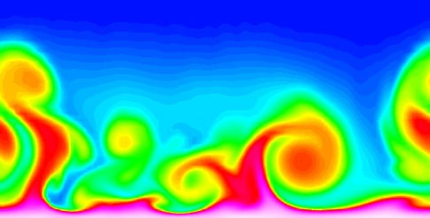
LARGE-SCALE DATA IS EVERYWHERE!
▶ There has been enormous data growth in both commercial and scientific databases due to advances in data generation and collection technologies
▶ New mantra
▶ Gather whatever data you can whenever and wherever possible.
▶ Expectations
▶ Gathered data will have value either for the purpose collected or for a purpose not envisioned.
E-Commerce
Cyber Security
Traffic Patterns
Social Networking: Twitter
Sensor Networks
Computational Simulations

Slide 4
WHY DATA MINING?
The Explosive Growth of Data: from terabytes to petabytes
Data collection and data availability
Automated data collection tools, database systems,Web, computerized society
Major sources of abundant data
Business:Web, e-commerce, transactions, stocks, …
Science: Remote sensing, bioinformatics, scientific simulation, …
Society and everyone: news, digital cameras,YouTube
We are drowning in data but starving for knowledge!
“Necessity is the mother of invention”— Data mining — Automated analysis of massive data sets
Notes:
Needed For decision making e.g…
1)customer profiling through clustering, decision trees, association rule mining
2) fraud detection through outliers etc…

Slide 5




WHY DATA MINING? COMMERCIAL VIEWPOINT
▶ Lots of data is being collected and warehoused
▶ Web data
▶ Google has Peta Bytes of web data
▶ Facebook has billions of active users
▶ Purchases at department/ grocery stores, e-commerce
▶ Amazon handles millions of visits/day
▶ Bank/Credit Card transactions
▶ Computers have become cheaper and more powerful
▶ Competitive Pressure is Strong
▶ Provide better, customized services for an edge (e.g., in Customer Relationship Management)

Slide 6
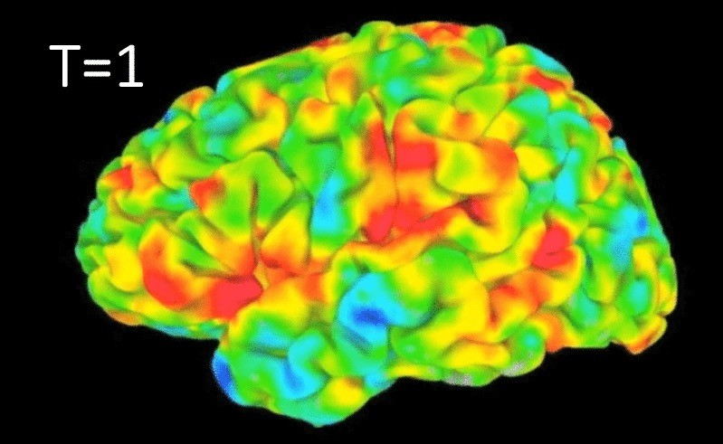

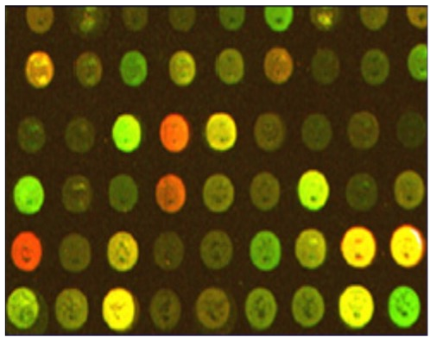
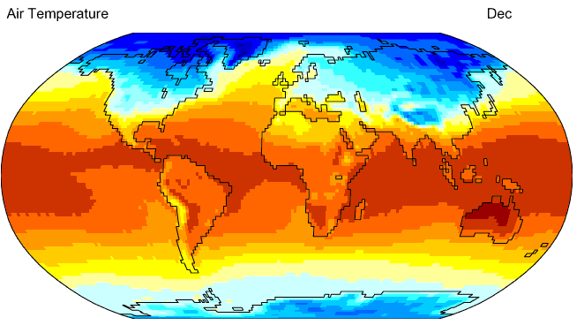
WHY DATA MINING? SCIENTIFIC VIEWPOINT
▶ Data collected and stored at enormous speeds
▶ remote sensors on a satellite
▶ NASA EOSDIS archives over petabytes of earth science data / year
▶ telescopes scanning the skies
▶ Sky survey data
▶ high-throughput biological data
▶ scientific simulations
▶ Terabytes of data generated in a few hours
▶ Data mining helps scientists
▶ In automated analysis of massive datasets
▶ In hypothesis formation
fMRI Data from Brain
Sky Survey Data
Surface Temperature of Earth
Gene Expression Data

Slide 7

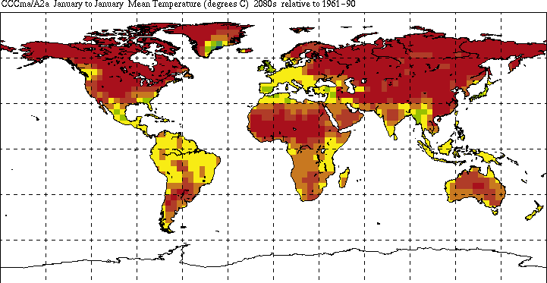


GREAT OPPORTUNITIES TO SOLVE SOCIETY’S MAJOR PROBLEMS
Improving health care and reducing costs
Predicting the impact of climate change
Reducing hunger and poverty by increasing agriculture production
Finding alternative/ green energy sources
8
Notes:
A. Disease prediction and prevention, clinical decision support, personalized medicine etc…
B. Pattern recognition for prediction, extreme weather event prediction/early warning, impact assessment(on crops)
C. Factors like energy consumption, energy sources, environmental factors, wind patterns by energy optimization
D. Factors like soil condition, climate impact, market trends, economic condition
1)Crops prediction and yield optimization by planning the schedules,pest control
2) Supply chain optimization for reaching the crops in market timely

Slide 8
WHAT IS DATA MINING?
Many Definitions:
Finding hidden information in a database
Exploration & analysis, by automatic or semi-automatic means, of large quantities of data in order to discover meaningful patterns
Non-trivial extraction of implicit, previously unknown and potentially useful information from data

Slide 9







WHAT IS DATA MINING?
Alternative names
Knowledge discovery (mining) in databases (KDD), knowledge extraction, data/pattern analysis, data archeology, data dredging, information harvesting, business intelligence, etc.
Watch out: Is everything “data mining”?
Simple search and query processing
(Deductive) expert systems

Slide 10
DATABASE PROCESSING VS. DATA MINING PROCESSING
Query
Well-defined
SQL
Data
Operational data
Output
Precise
Subset of database
Query
Poorly defined
No precise query language
Future trends in DM
Data
No operational data
Output
Fuzzy
Not a subset of database

Slide 11
QUERY EXAMPLES
Database:
Find all credit applicants with last name of Numan.
Identify customers who have purchased more than Rs.10,000 in the last month.
Find all customers who have purchased milk
Data Mining:
Find all credit applicants who are poor credit risks. (classification)
Identify customers with similar buying habits. (clustering)
Find all items which are frequently purchased with milk. (association rules)
Notes:
Entire dataset analysis, knowledge not info, not predefined output, not matching criteria,

Slide 12
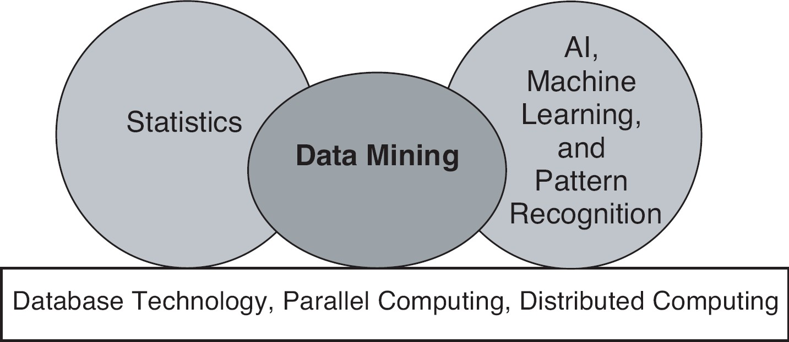
ORIGINS OF DATA MINING
Draws ideas from machine learning/AI, pattern recognition, statistics, and database systems
Traditional techniques may be unsuitable due to data that is
Large-scale
High dimensional
Heterogeneous
Complex
Distributed
Data mining is a key component of the emerging field of data science and data-driven discovery.
Notes:
Traditinal techniques may be manual sampling, conventional database system, SQL,

Slide 13
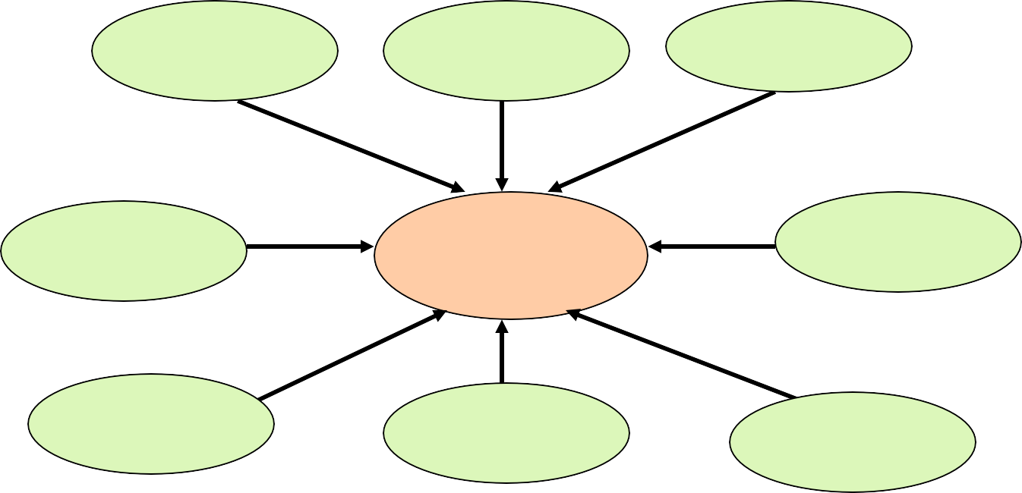
DATA MINING: CONFLUENCE OF MULTIPLE DISCIPLINES
Machine Learning
Pattern Recognition
Statistics
Applications
Data Mining
Visualization
Algorithm
Database Technology
High-Performance Computing

Slide 14
WHY CONFLUENCE OF MULTIPLE DISCIPLINES?
Tremendous amount of data
Algorithms must be highly scalable to handle such as tera-bytes of data
High-dimensionality of data
Micro-array may have tens of thousands of dimensions
High complexity of data
Data streams and sensor data
Time-series data, temporal data, sequence data
Structure data, graphs, social networks and multi-linked data
Heterogeneous databases and legacy databases
Spatial, spatiotemporal, multimedia, text and Web data
Software programs, scientific simulations
New and sophisticated applications

Slide 15
MYSELF, COURSE & CONDUCT

Slide 16

HOW TO REACH ME?
Office: Room # 132, Computer Science Dept., Faculty Offices – 1st floor
Office Visiting Hours: to be provided soon
Email: ayesha.liaqat@nu.edu.pk
Write a “good” email to get timely response

Slide 17
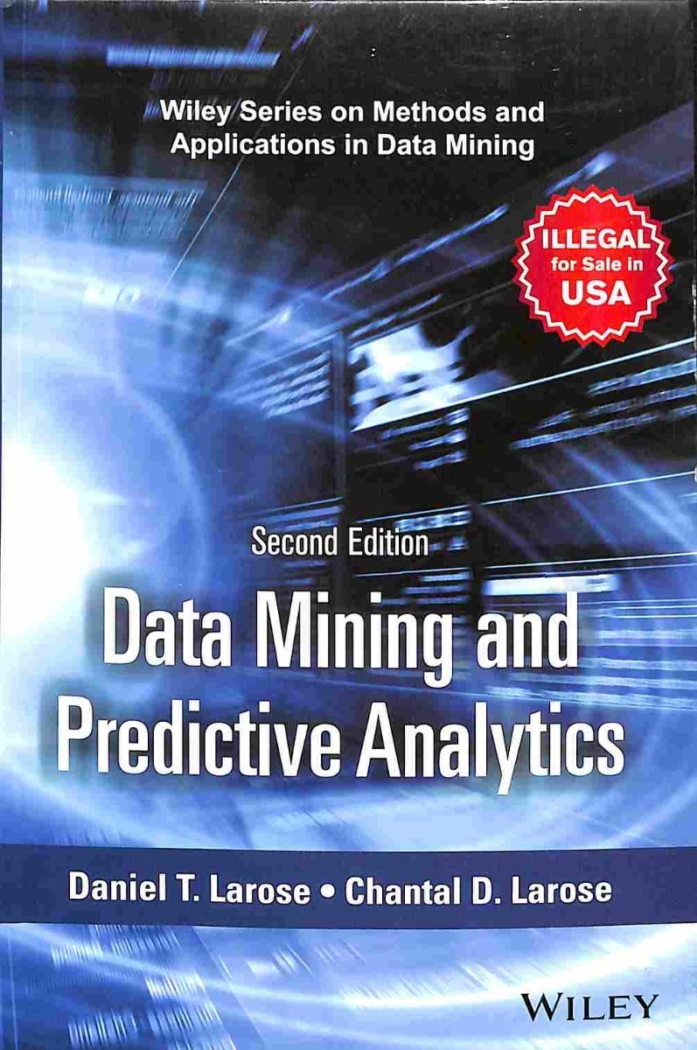
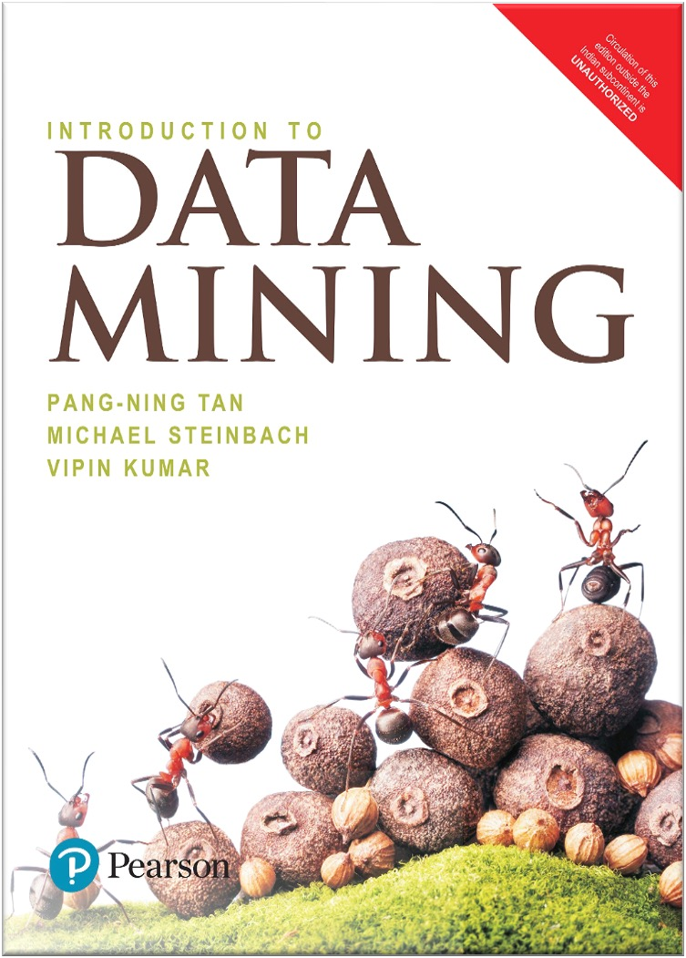
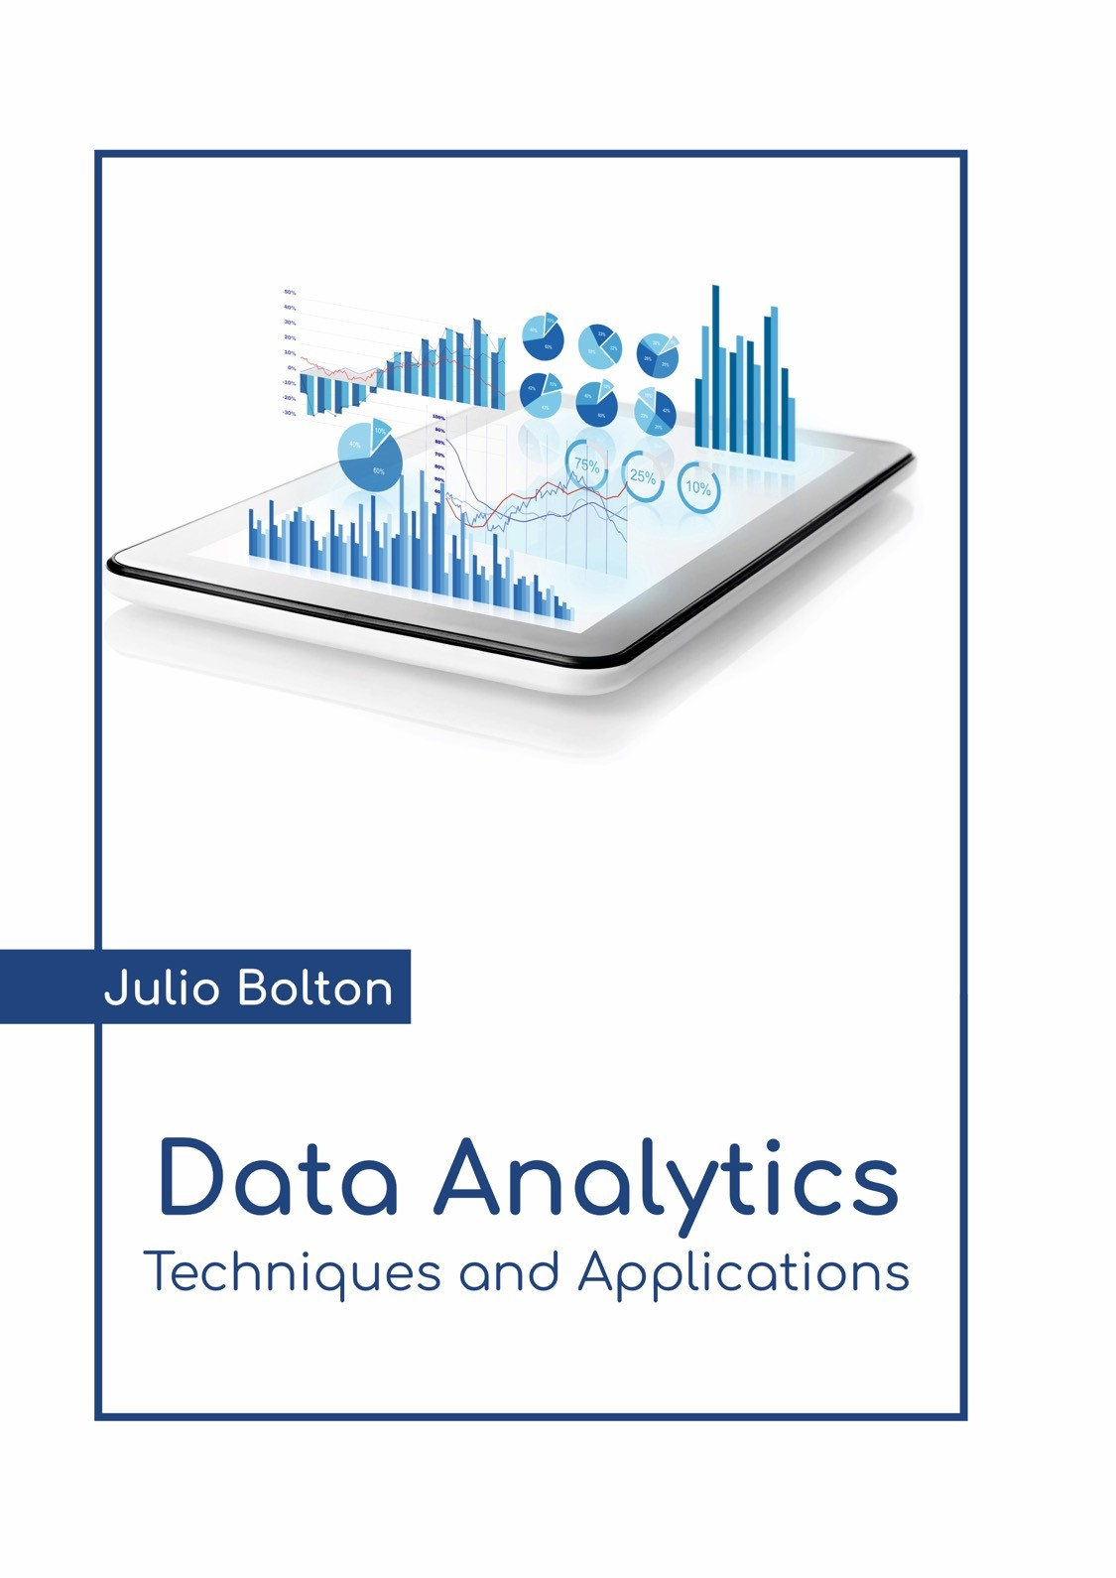
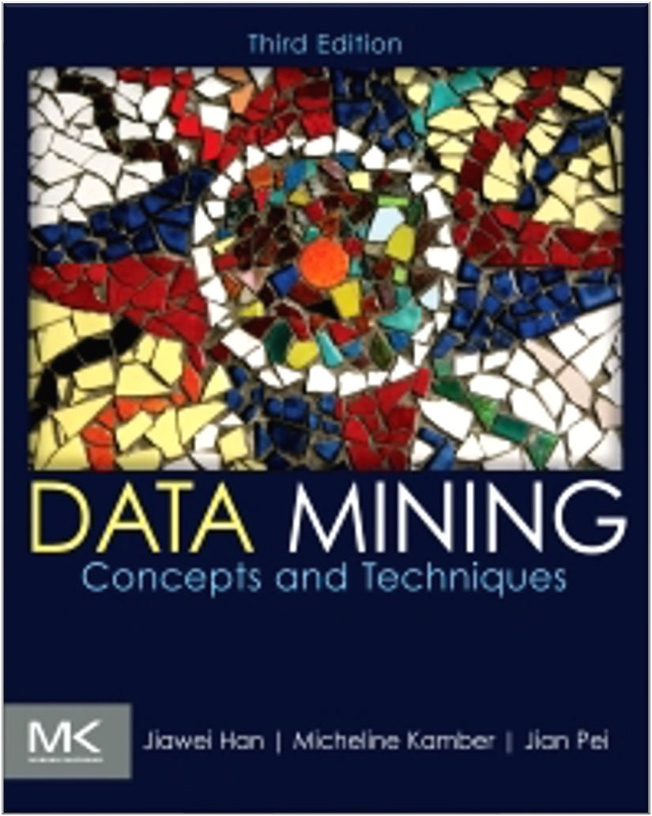
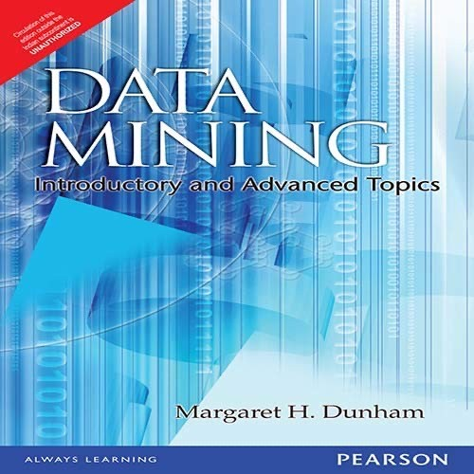
COURSE BOOKS
MATERIAL IN THE LECTURE SLIDES WILL BE ADAPTED FROM OFFICIAL SLIDES OF THE TWO TEXTBOOKS, BUT, MAJORLY FROM “INTRODUCTION TO DATA MINING”, 2ND EDITION BY TAN, STEINBACH, KARPATNE, KUMAR

Slide 18
TENTATIVE MARKS DISTRIBUTION
Item Name | Quantity | Marks (%)
Class participation [Individual + Group] | - | 5%
Assignments [Individual ] | 03-04 | 15%
Mid Exams | 02 | 30% [15 abs. each]
Project (case study) [2 persons team] | 01 | 10%
Final Exam | 01 | 40%
No retakes for missed class participation tasks
DATA MINING - F
ALL 2022
22

Slide 19
COURSE OUTLINE
3 Credit Hours/Elective
Relative Grading
Data Mining Introduction • (1 Week)
Data Understanding and Visualization
(2 Weeks)
Data Pre-processing
(3 Weeks)
Classification Algorithms
(3 Weeks)
Pattern Mining
(3 Weeks)
Clustering Algorithms
(3 Weeks)
23

Slide 20
COURSE OBJECTIVES
To familiarize students with basic and some advanced data mining techniques and related concepts.
To develop data analysis and modeling skills that are mandatory to solve a real-life problem using data mining concepts.
To prepare students for analyzing and selecting best approaches for different kinds of data.
To given hands-on experience of applying data mining methods using tools and languages on real datasets.

Slide 21




TOOLS AND LANGUAGES
EXPLORE AND WORK ON DIFFERENT TOOLS AND LANGUAGES TO COMPLETE COURSE PROJECT(S)

